Slide 1

CLOUD COMPUTING
By Faisal

Slide 2


Beginning Amazon Web Services
Chapters
What is cloud computing?
Benefits of cloud computing
Amazon Web Services (AWS)
Other cloud providers

Slide 3

Beginning Amazon Web Services
What is cloud computing?
On-demand delivery of IT resources
Via the internet
With pay-as-you-go pricing
Notes:
Think of cloud computing as the del of conouting services ondemand. What kind of services? Pretty mich anything. From applications to data to syorage to networking or just processing power. User can access the cloud to get just about any IT service then requires, when they require.
Instead of buying owning and managing you rown data centers you can access them as you need.
Talk about the OSS story and how it facilitates the dev of services

Slide 4
Beginning Amazon Web Services
Benefits of cloud computing
Agility
Cost savings
Elasticity
Global
Security
Notes:
Agility = Fail fast, experiment, innovate. Cloud iinovate on your behalf. Talk about some examples.
Cost = only pay what you need
Elasticity = scale up and down
Global
Security

Slide 5
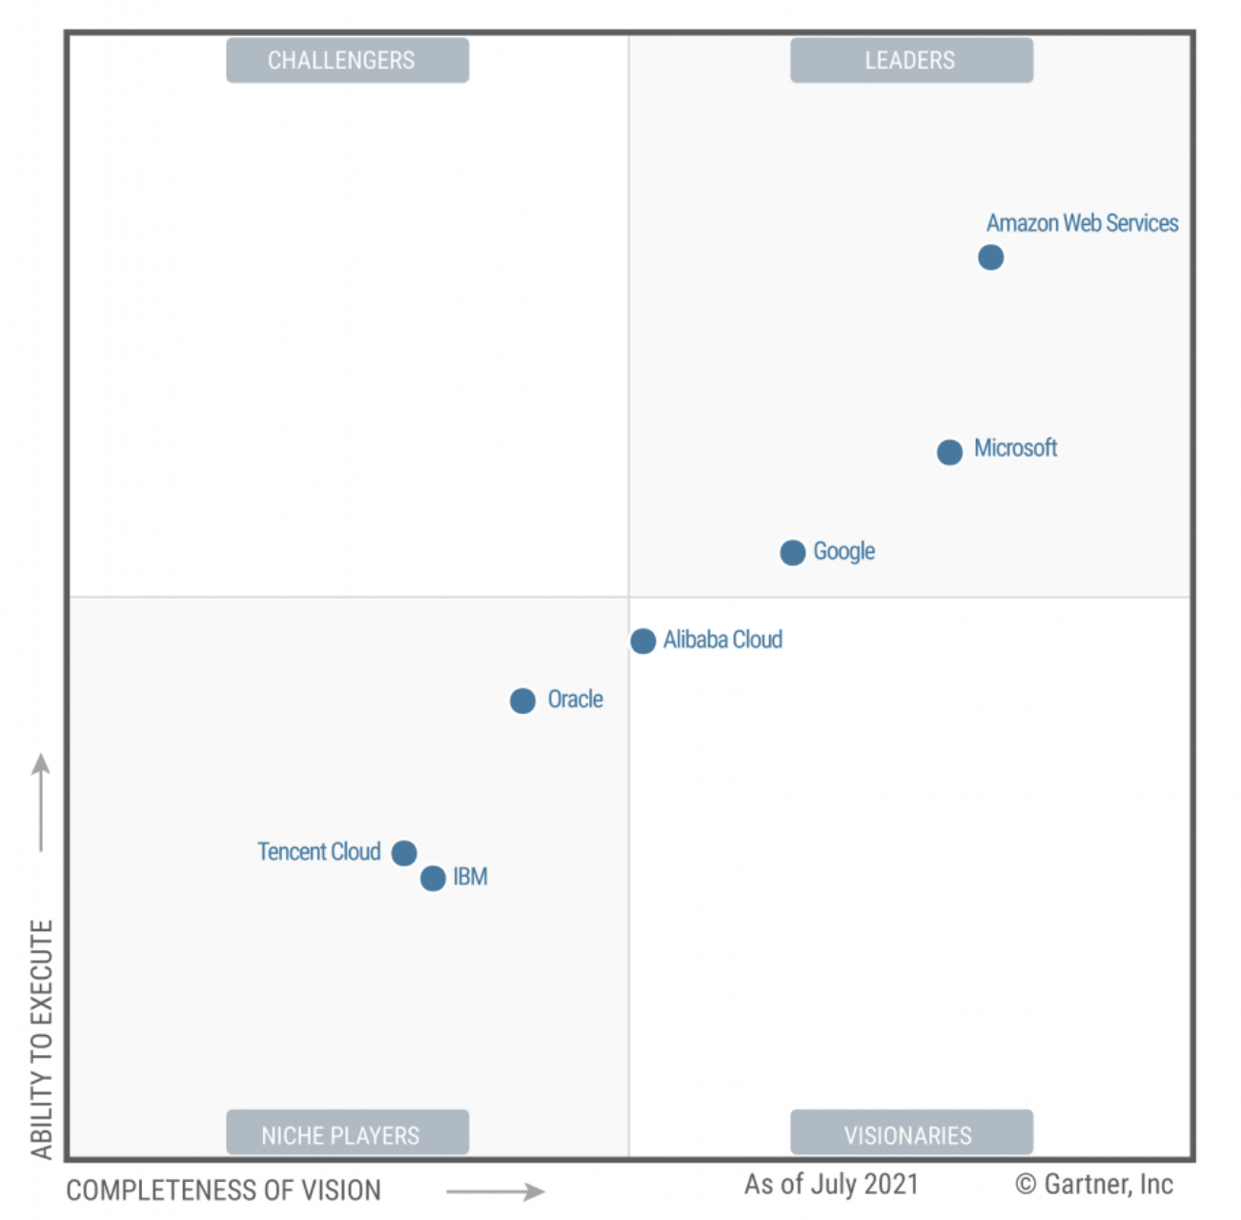
Beginning Amazon Web Services
Amazon Web Services (AWS)
Pioneer
Leader
Notes:
Scale = talk about data centers
AWS
Leader = Gartner = https://aws.amazon.com/blogs/aws/aws-named-as-a-leader-for-the-11th-consecutive-year-in-2021-gartner-magic-quadrant-for-cloud-infrastructure-platform-services-cips/

Slide 6
Beginning Amazon Web Services
Amazon Web Services (AWS)
245 countries and
territories
200+ fully feature services
400 types of compute instances
Pioneer
Leader
Scale
Notes:
Talk about some of the services
App Dev, Analytics, ML, IoT, Media, Mobile, Database
Core = comouter, network, storage
Security and Compliance
Infra
Management tool/Observability

Slide 7



Beginning Amazon Web Services
Other cloud providers

Slide 8

Beginning Amazon Web Services
Summary
Cloud computing and its benefits
Amazon Web Services
Other cloud vendors
Next Steps
Notes:
Talk about how easy is to start. Just logni to aws console and start trying…

